Slide 1
Product Introduction
2011
www.cresyn.com

Slide 2
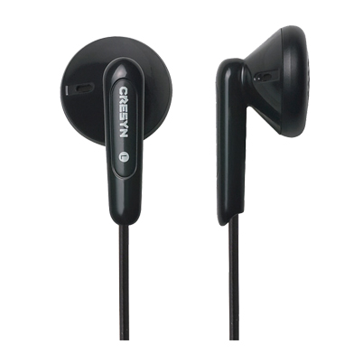
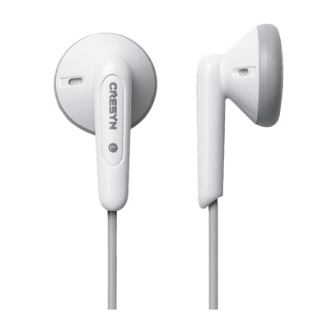
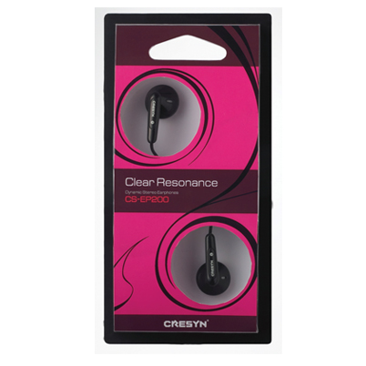
Dynamic Stereo Earphones
CS-EP200
Features
Simple and Cute design
Dynamic Sound with Deep Bass
Color : Black or White
Specifications
Type : Open air, Dynamic Driver Units : Ø 15 mm Impedance : 32 Ω Sensitivity : 95 dB/mW Max. Input Power : 40 mW
Frequency Response : 20 ~ 20,000 Hz
Cord Length : 1.2 m
Plug : 3.5 mm stereo gold-plated plug Weight : 4 g (Except cord)

Slide 3
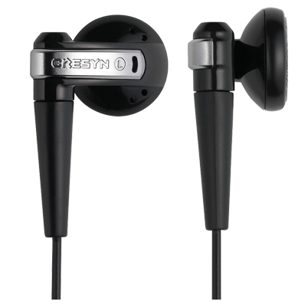
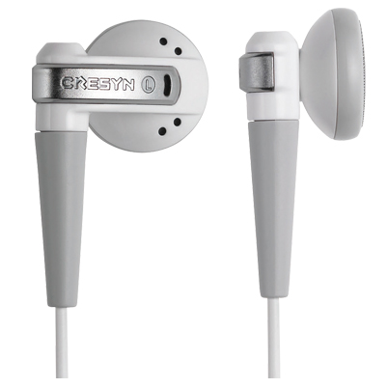
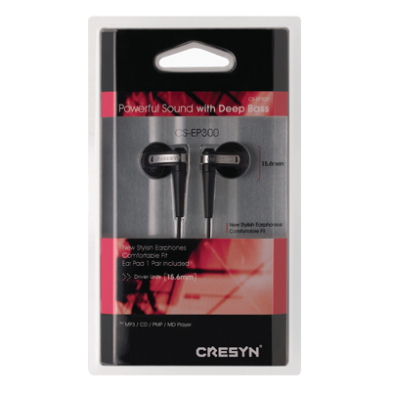
Dynamic Stereo Earphones
CS-EP300
Features
Unique design & Dynamic sounds Color : Black or White
Specifications
Type : Open air, Dynamic Driver Units : Ø 15.6 mm Impedance : 32 Ω Sensitivity : 98 dB/mW Max. Input Power : 40 mW
Frequency Response : 12 ~ 22,000 Hz
Cord Length : 1.2 m
Plug : 3.5 mm stereo gold-plated plug Weight : 5.5 g (Except cord)
Accessory : Ear Pad 2 pair

Slide 4
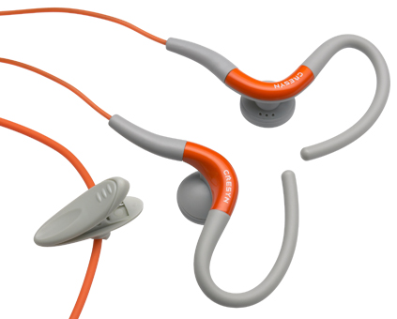
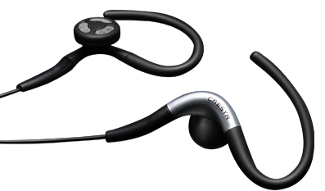
Sports Gear
C220E
Features
Ergonomic design & Durable Body
Dynamic Sound with Deep Bass
Ultra Light Weight
Color : Black or Orange
Specifications
Type : Open air, Dynamic Driver Units : Ø 15 mm Impedance : 16 Ω Sensitivity : 98 dB/mW Max. Input Power : 40 mW
Frequency Response : 20 ~ 20,000 Hz
Cord Length : 1.2 m
Plug : 3.5 mm stereo gold-plated plug Weight : 3.5 g (Except cord)

Slide 5
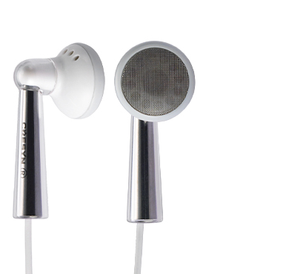
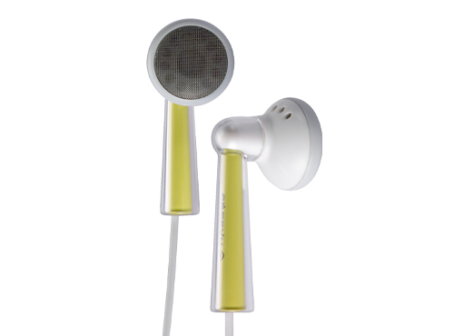
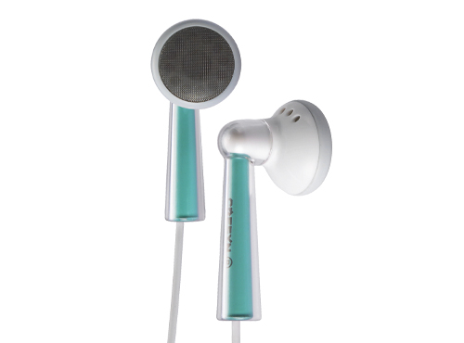
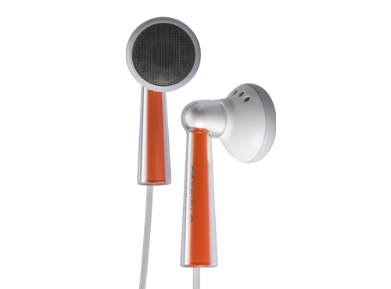
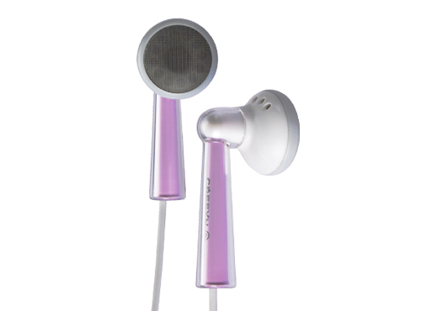
Stylish Stereo Earphones
C240E
Features
Color matched with I-Pod
Dynamic Sound and Comfortable fit
Powerful base
Specifications
Type : Open air, Dynamic Driver Units : Ø 16 mm Impedance : 32 Ω Sensitivity : 98 dB/mW Max. Input Power : 40 mW
Frequency Response : 12 ~ 22,000 Hz
Cord Length : 1.2 m
Plug : 3.5 mm stereo gold-plated plug Weight : 7.4 g (Except cord)
Chrome
Yellow
Green
Orange
Violet

Slide 6
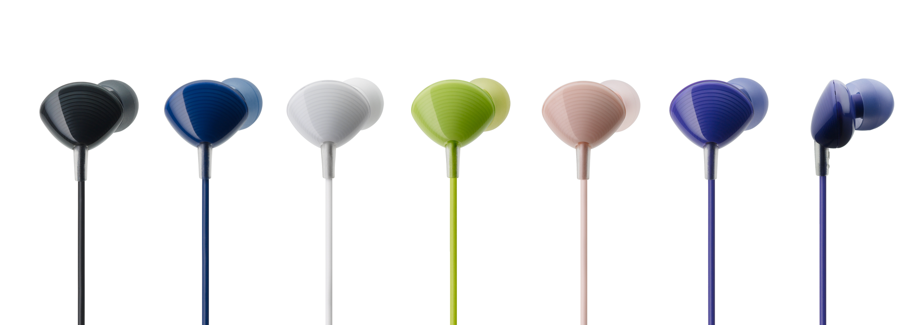
Dynamic Stereo In-ear Earphones
C350E (SHELL)
Features
Shell design with 6 different colors
Sound Isolating Design & Dynamic Sound Comfortable fit
Specification (Earphone)
Type : Canal Driver Units : Ø 8.8 mm Impedance : 16 Ω Sensitivity : 89 dB/mW Max. Input Power : 20 mW Frequency Response : 20 ~ 20,000 Hz Cord Length : 1.2 m Plug : 3.5 mm stereo plug
Cord style : Symmetrical type

Slide 7
Stylish Stereo Earphones
AXE4
Features
Premium Soft textile cord
Dynamic Powerful Sound
Specifications
Type : Open air, Dynamic Driver Units : Ø 15 mm Impedance : 16 Ω Sensitivity : 96 dB/mW Max. Input Power : 40 mW
Frequency Response : 20 ~ 20,000 Hz
Cord Length : 1.2 m
Plug : 3.5 mm stereo gold-plated plug
Weight : 3.5g (except cord)
Supplied accessory : POUCH

Slide 8
Stylish Stereo Earphones
C470E
Features
REBIRTH OF LEGENDARY SOUND
Colors : Pink & Green
Specifications
Type : Open air, Dynamic Driver Units : Ø 16 mm Impedance : 16 Ω Sensitivity : 110 dB/mW Max. Input Power : 50 mW
Frequency Response : 8 ~ 27,000 Hz
Cord Length : 1.2 m
Plug : 3.5 mm stereo gold-plated plug
Supplied accessory : Pouch, Cord clip

Slide 9
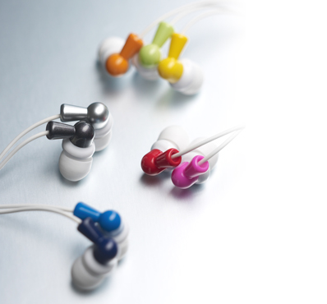
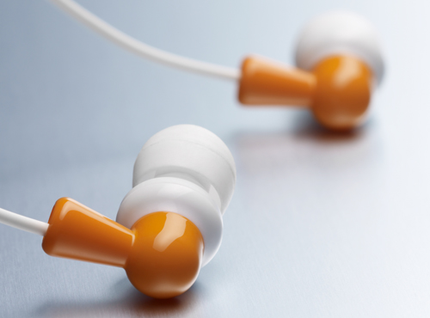
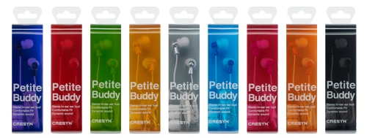
Petite Buddy (In-ear Earphones)
C222E
Features Color Matching with I-pod Stylish and cute design
Sound Isolating Design & Dynamic Sound
Specifications Type : Closed, Dynamic Driver Units : Ø 8.8 mm Impedance : 16 Ω Sensitivity : 91 dB/mW Max. Input Power: 40 mW
Frequency Response : 20 ~ 20,000 Hz Cord Length : 1.2 m
Plug : 3.5 mm stereo gold-plated plug Weight : 2.6 g (Except cord)
Accessory : Ear Tip (S,M,L)

Slide 10
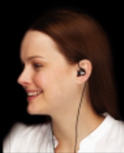
Dynamic Stereo In-ear Earphones
C230E
Features Sound Isolating Design & Dynamic Sound
Unique Water-drop shape Comfortable fit
Colors : Black & White
Specifications Type : Closed, Dynamic Driver Units : Ø 8.8 mm Impedance : 16 Ω Sensitivity : 90 dB/mW Max. Input Power: 40 mW
Frequency Response : 20 ~ 20,000 Hz Cord Length : 1.2 m
Plug : 3.5 mm stereo gold-plated plug Weight : 3.5 g (Except cord)
Accessory : Ear Tip (S,M,L)

Slide 11
Dynamic Stereo In-ear Earphones
C330E
Features
Sound Isolating Design & Dynamic Sound
Comfortable fit Color : Black / White
Specification (Earphone)
Type : Canal Driver Units : Ø 8.8 mm Impedance : 16 Ω Sensitivity : 91 dB/mW Max. Input Power : 40 mW Frequency Response : 20 ~ 20,000 Hz Cord Length : 1.2 m Plug : 3.5 mm stereo gold-plated plug
Cord style : Symmetrical type
Accessories: 3 Sizes of ear tips

Slide 12
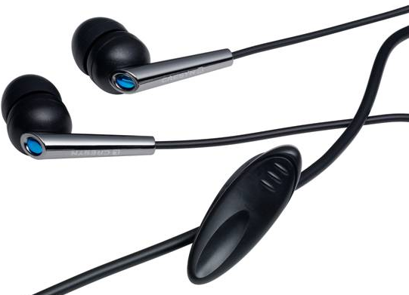
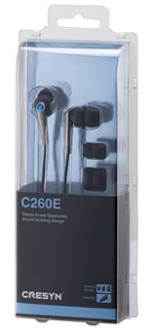
Dynamic Stereo In-ear Earphones
C260E
Features Sound Isolating Design & Dynamic Sound Color : Black / White / Pink / Red
Specifications Type : Closed, Dynamic Driver Units : Ø 8.8 mm Impedance : 16 Ω Sensitivity : 91 dB/mW Max. Input Power: 40 mW
Frequency Response : 20 ~ 20,000 Hz Cord Length : 1.2 m
Plug : 3.5 mm stereo gold-plated plug Weight : 5.3 g (Except cord)
Accessory : Ear Tip (S,M,L), Cord Clip

Slide 13
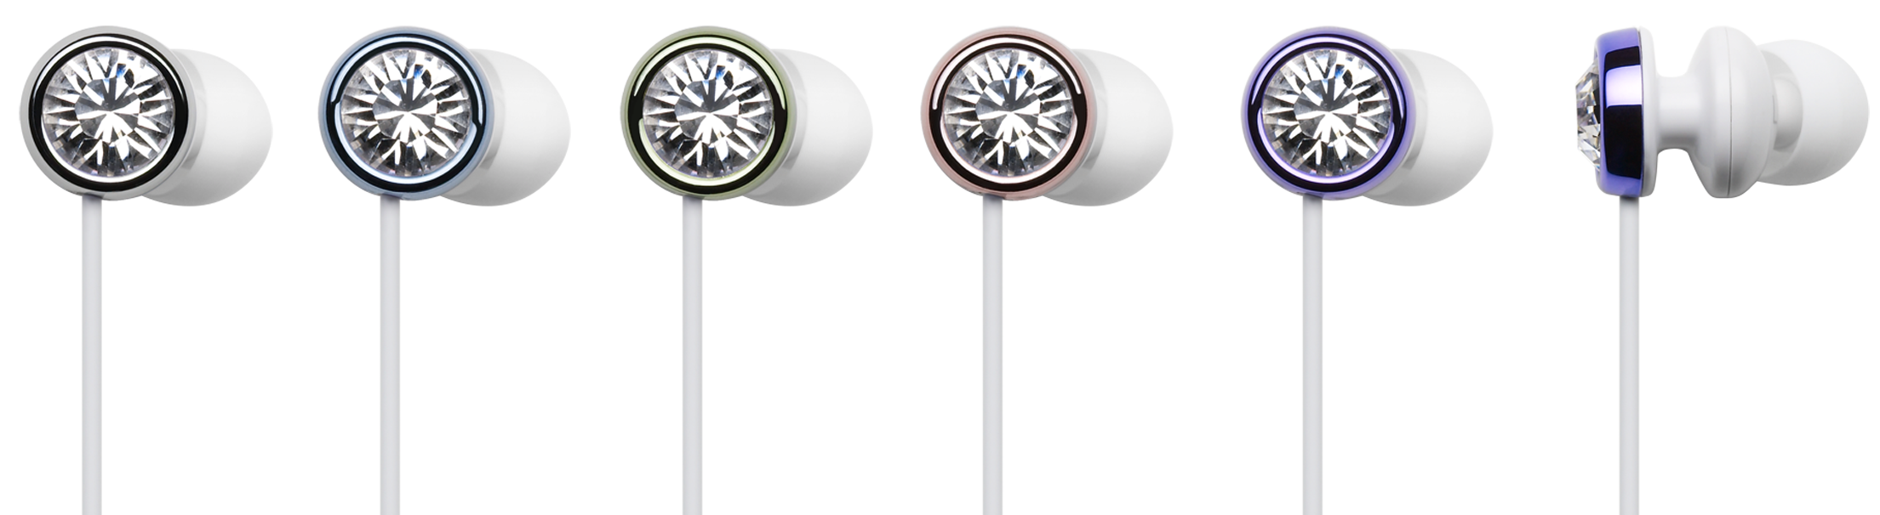
Premium Earphone with Real Swarovski Cristal
C410E (Bijoux)
Features
* Crystal Clear sound
* Bijoux twinkles from every direction with real Swalovski's Crystal
* Blocking out all background noise by premium canal type
* 6 kind of various colors for better choice
Specification
Type : Canal Driver Units : Ø 8.8 mm Impedance : 16 Ω Sensitivity : 89 dB/mW Max. Input Power : 20 mW Frequency Response : 20 ~ 20,000 Hz Cord Length : 1.2 m Plug : 3.5 mm stereo plug
Cord style : Symmetrical type

Slide 14
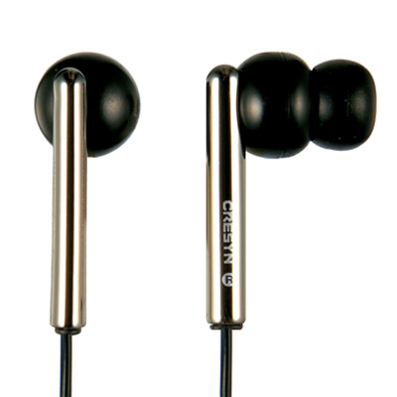
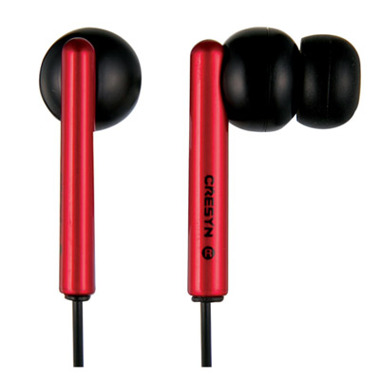
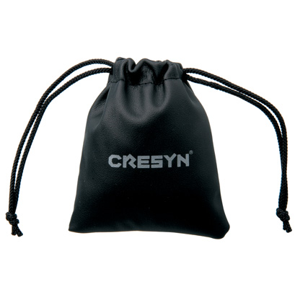
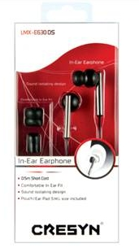
Dynamic Stereo In-ear Earphones
LMX-E630
Features Unique Metallic body Sound Isolating Design & Dynamic Sound Color : Metallic Black or Red
Specifications Type : Closed, Dynamic Driver Units : Ø 11.5 mm Impedance : 16 Ω Sensitivity : 97 dB/mW Max. Input Power: 40 mW
Frequency Response : 20 ~ 20,000 Hz Cord Length : 1.2 m
Plug : 3.5 mm stereo gold-plated plug Weight : 5.5 g (Except cord)
Accessory : Ear Tip (S,M,L), Carrying Pouch

Slide 15
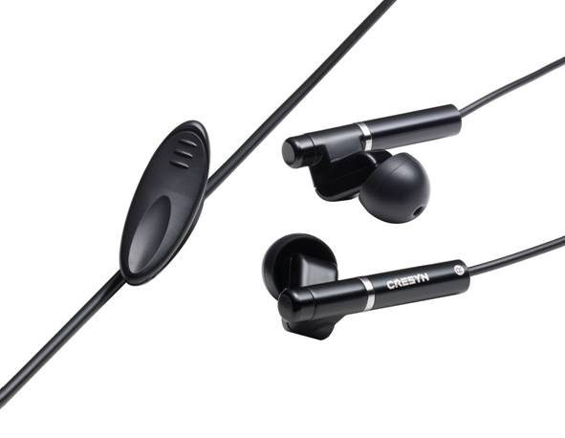
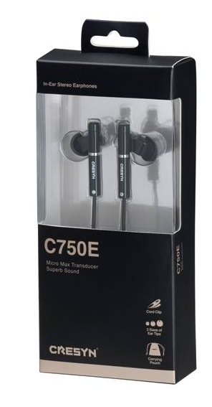
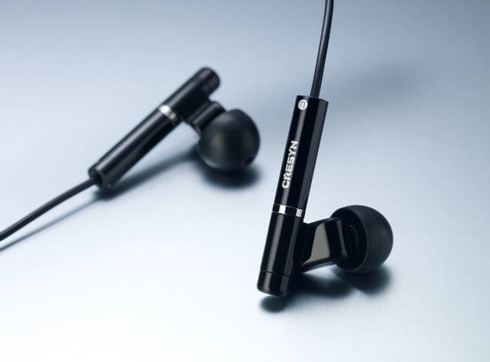
Prime Stereo In-ear Earphones
C750E
Features Dynamic High Definition Sound through BA (balanced Amateur) driver
Ultra Light Weight
Sound Isolating Design Color : Black
Specifications Type : Balanced Armature Micro Driver
Impedance : 24 Ω Sensitivity : 115 dB/mW Max. Input Power : 80 mW
Frequency Response : 8 ~ 27,000 Hz Cord Length : 1.2 m
Plug : 3.5 mm stereo gold-plated plug Weight : 4 g (Except cord)
Accessory : Ear Tip (S,M,L), Carrying Pouch

Slide 16
Dynamic Clip-on Headphones
CS-CH300
Features
Ergonomic Clip Design
Dynamic Sound with Deep Bass
Color : Pink or Silver
Specifications
Type : Open air, Dynamic Driver Units : Ø 28 mm Impedance : 20 Ω Sensitivity : 102 dB/mW Max. Input Power : 500 mW
Frequency Response : 16 ~ 24,000 Hz Plug : 3.5 mm stereo gold-plated plug Weight : 30 g (Except cord)

Slide 17
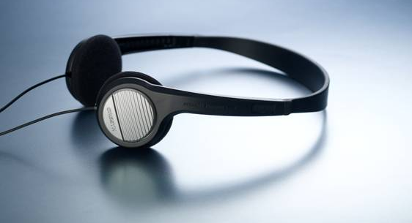
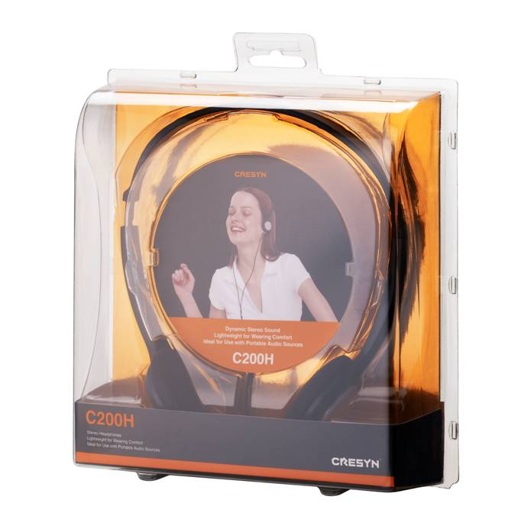
Dynamic Stereo Headphones
C200H
Features Ultra Light weight Adjustable Head Band Dynamic Sound with Deep Bass Color : Black or White
Specification
Type : Open air, Dynamic Driver Units : Ø 28 mm Impedance : 30 Ω Sensitivity : 98 dB/mW Max. Input Power : 1,000 mW Frequency Response : 20 ~ 20,000 Hz Cord Length : 1.5 m Plug : 3.5 mm stereo gold-plated plug Weight : 60 g (Except cord)

Slide 18
Foldable Stereo Headphones
C510H
Features
Adjustable Head Band
Durable Body and Folding Design
Balanced Sound Reproduction
Specification (Earphone)
Type : Open air, Dynamic Driver Units : Ø 38 mm Impedance : 35 Ω
Sensitivity : 101 dB/mW Max. Input Power : 1,000 mW
Frequency Response : 20 ~ 20,000 Hz Cord Length : 1.5 m
Plug : 3.5 mm stereo gold-plated plug
Accessories: 6.3mm stereo adapter &
Carrying Case

Slide 19
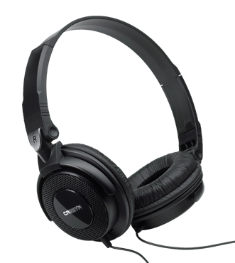
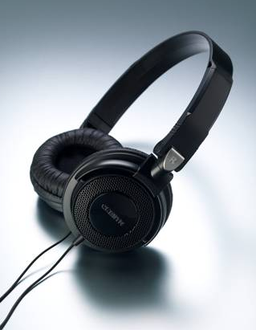
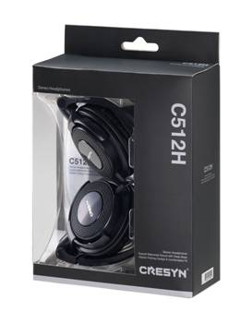
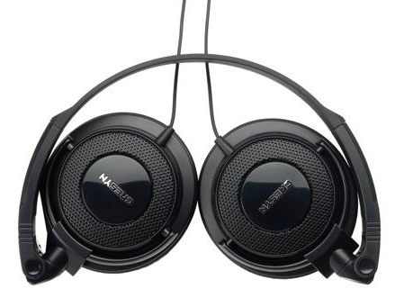
Foldable Stereo Headphones
C512H
Features
Adjustable Head Band
Durable Body and Folding Design
Balanced Sound Reproduction
Specification
Type : Open air, Dynamic Driver Units : Ø 38 mm Impedance : 35 Ω
Sensitivity : 101 dB/mW Max. Input Power : 1,000 mW
Frequency Response : 20 ~ 20,000 Hz Cord Length : 1.5 m
Plug : 3.5 mm stereo gold-plated plug
Weight : 107 g (Except cord)

Slide 20
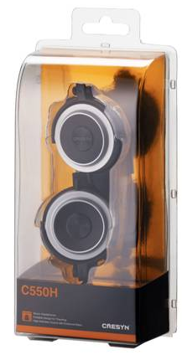
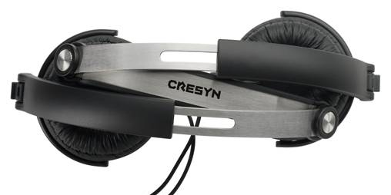
Portable Stereo Headphones
C550H
Features
Specific Durable Folding Mechanism
Ergonomic Head Band Design
Dynamic Sound with Deep Bass
Specification
Type : Closed air, Dynamic Driver Units : Ø 40 mm Impedance : 40 Ω
Sensitivity : 106 dB/mW Max. Input Power : 1,000 mW
Frequency Response : 10 ~ 21,000 Hz Cord Length : 1.5 m
Plug : 3.5 mm stereo gold-plated plug
Weight : 85 g (Except cord)

Slide 21
Fashionable Headphone
C300H (PASTEL)
Features
Stainless metal Head Band
with Soft ear-pad gives comfortableness
Produce Balanced Sound with 40mm Unit
Specification (Earphone)
Type : Open air, Dynamic Driver Units : Ø 40 mm Impedance : 32 Ω
Sensitivity : 97 dB/mW Max. Input Power : 500 mW
Frequency Response : 20 ~ 20,000 Hz Cord Length : 1.2 m
Plug : 3.5 mm stereo plug

Slide 22
Fashionable Headphone
C515H (DISC)
Features
Fashionable Disc design
Comfortable fit with
Produce Balanced Sound with 40mm Unit
Specification (Earphone)
Type : Open air, Dynamic Driver Units : Ø 40 mm Impedance : 32 Ω
Sensitivity : 97 dB/mW Max. Input Power : 500 mW
Frequency Response : 20 ~ 20,000 Hz Cord Length : 1.2 m
Plug : 3.5 mm stereo plug

Slide 23
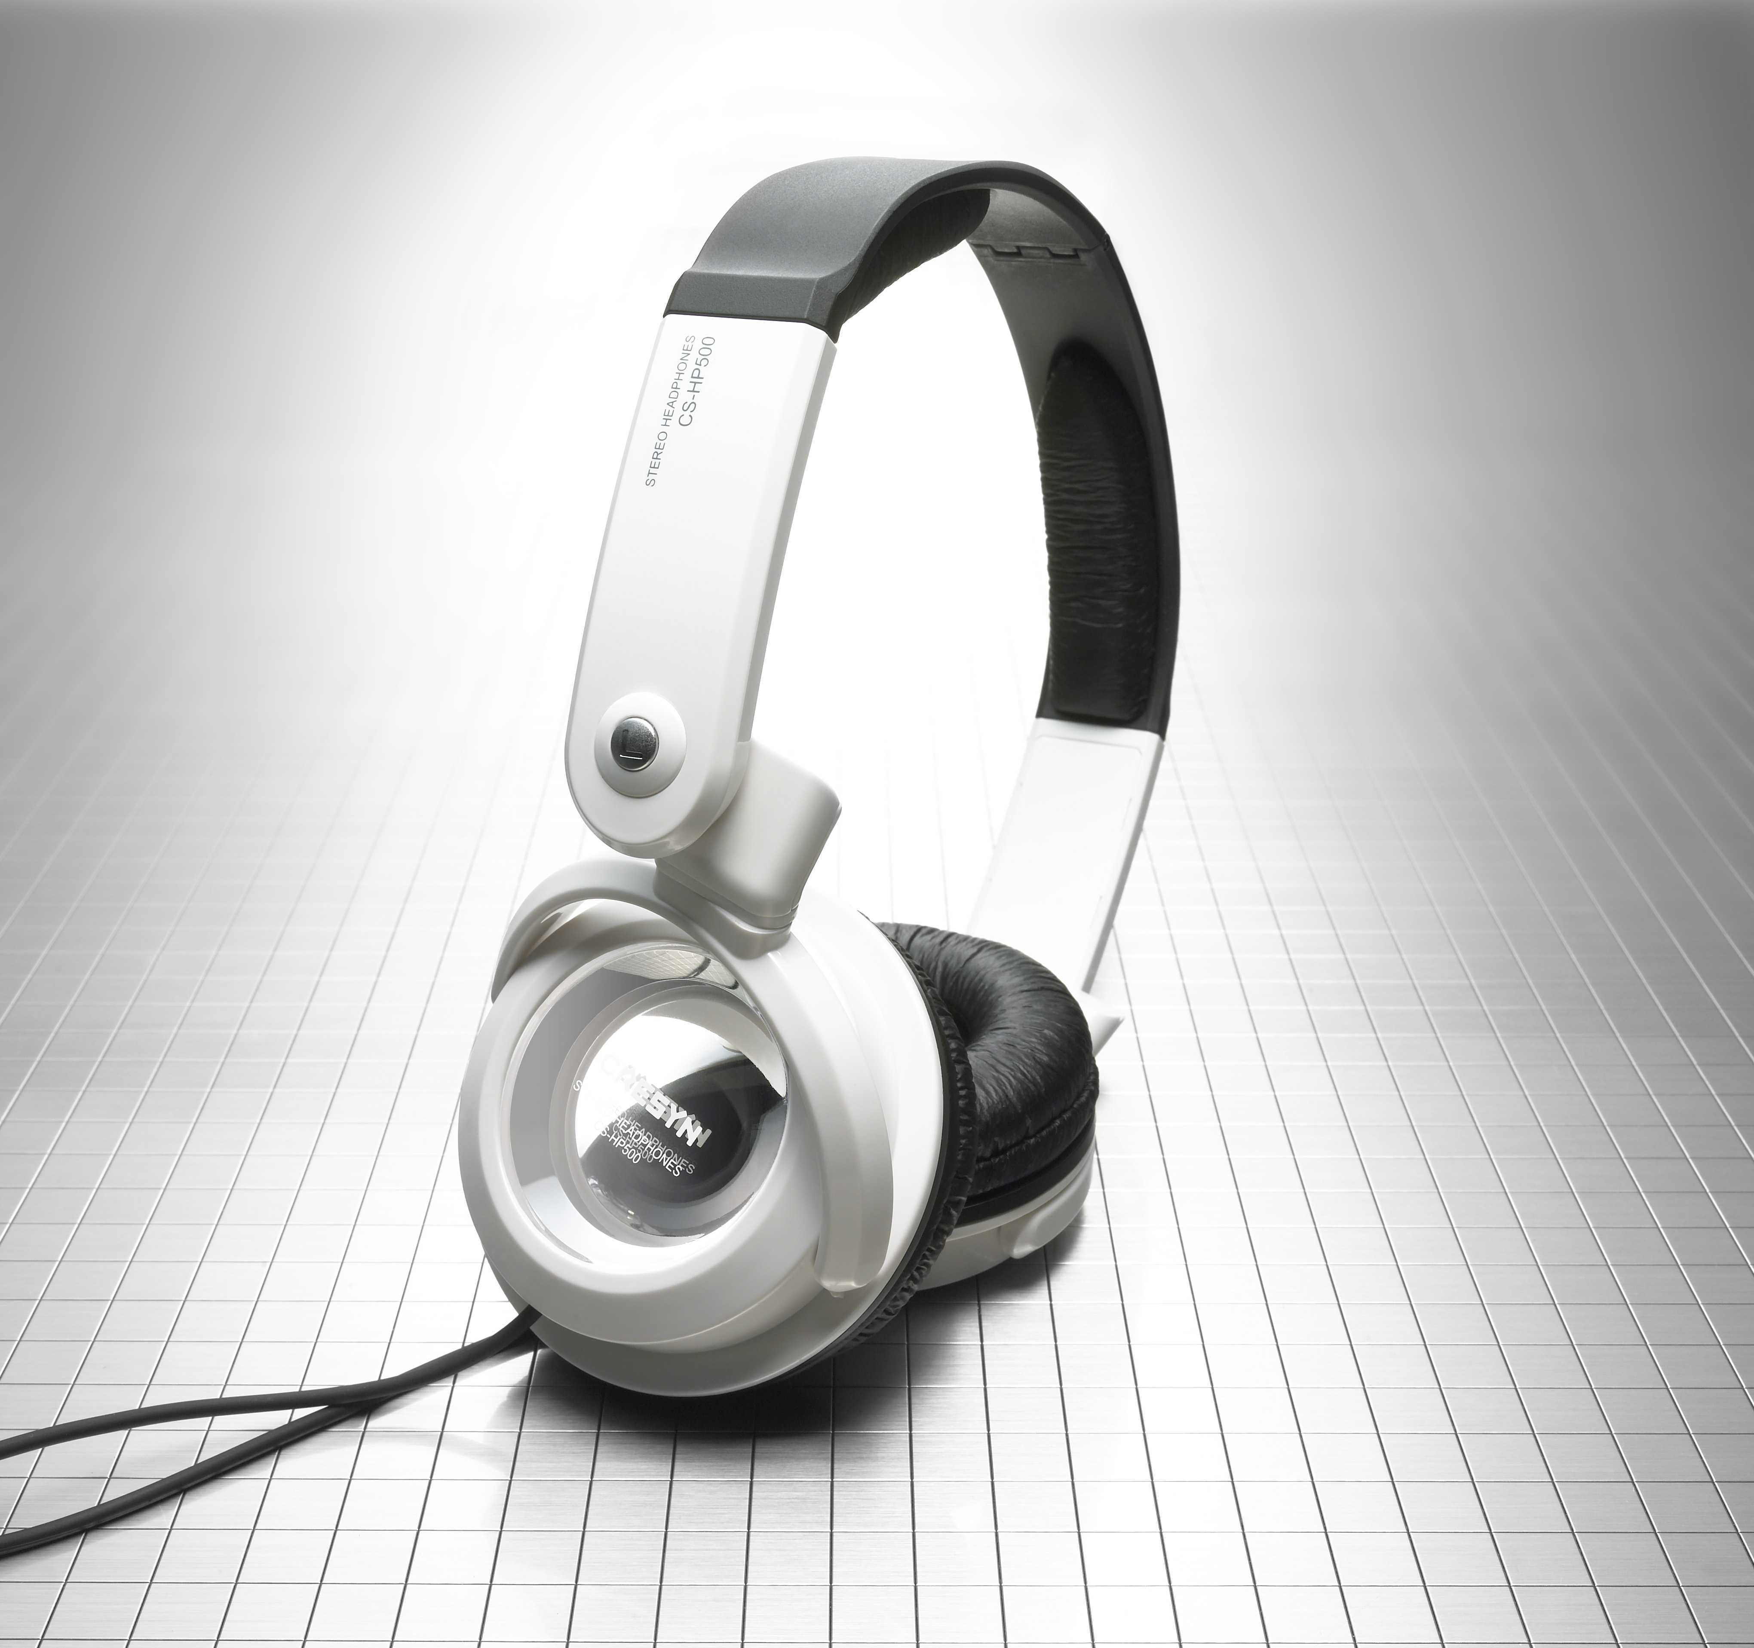
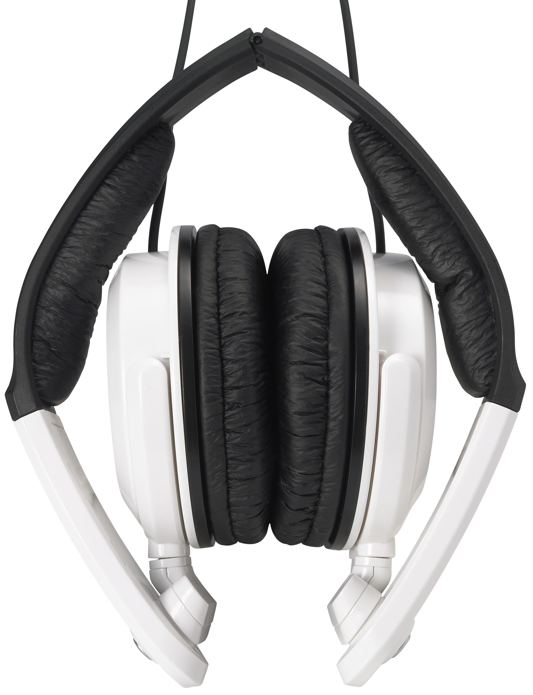
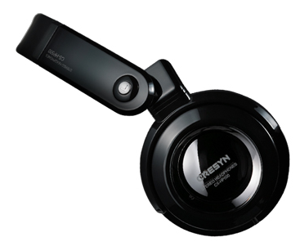
Foldable Stereo Headphones
CS-HP500
Features Powerful Bass Adjustable Head Band Simple foldable mechanic for comfortable Color : Black or White or Red
Specification
Type : Open air, Dynamic Driver Units : Ø 38 mm Impedance : 35 Ω Sensitivity : 100 dB/mW Max. Input Power : 1,000 mW Frequency Response : 20 ~ 20,000 Hz Cord Length : 1.5 m Plug : 3.5 mm stereo gold-plated plug Weight : 124 g (Except cord)
Accessory : 6.3mm universal adaptor,
Carrying Pouch

Slide 24
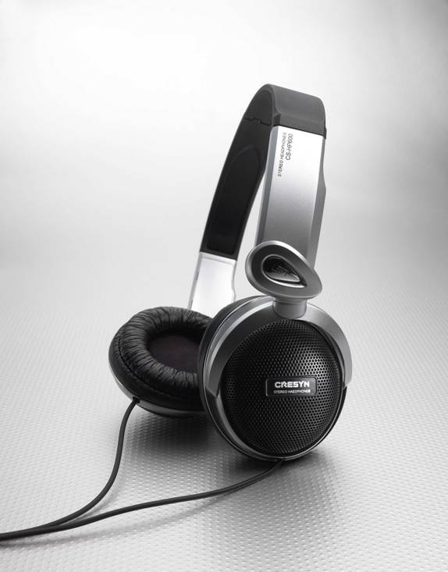
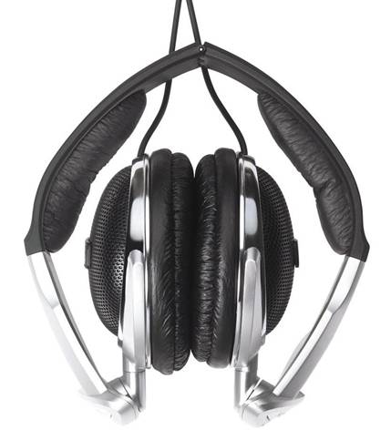
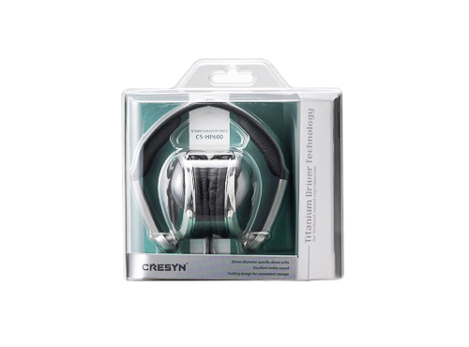
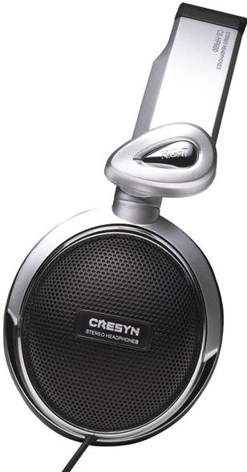
Foldable Stereo Headphones
CS-HP600
Features Titanium Driver Technology Adjustable Head Band Simple foldable mechanic for comfortable
Specification
Type : Closed air, Dynamic Driver Units : Ø 38 mm Impedance : 35 Ω Sensitivity : 100 dB/mW Max. Input Power : 1,000 mW Frequency Response : 20 ~ 20,000 Hz Cord Length : 1.5 m Plug : 3.5 mm stereo gold-plated plug Weight : 138 g (Except cord)
Accessory : 6.3mm universal adaptor,
Carrying Pouch

Slide 25
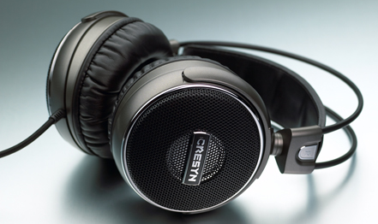
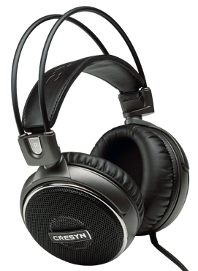
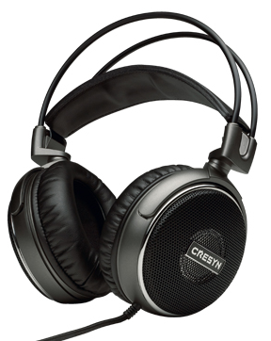
Hi-Fi Stereo Headphones
C720H
Features 40mm diameter high quality driver unit Adjustable Head Band Superb balanced sound Ergonomic design and comfortable fit
Specification
Type : Closed air, Dynamic Driver Units : Ø 40 mm Impedance : 32 Ω Sensitivity : 100 dB/mW Max. Input Power : 2,000 mW Frequency Response : 10 ~ 25,000 Hz Cord Length : 3.0 m Plug : 3.5 mm stereo gold-plated plug Weight : 325 g (Except cord)
Accessory : 6.3mm universal adaptor,

Slide 26
Earphone with Microphone
C161S
Features Optimized for Computer(internet) phone calls / Compatible with VoIP & Messenger
Specification (Earphone)
Type : Closed air, Dynamic Driver Units : Ø 15 mm Impedance : 32 Ω Sensitivity : 94 dB/mW Max. Input Power : 20 mW Frequency Response : 20 ~ 20,000 Hz Cord Length : 1.2 m Plug : 3.5 mm stereo gold-plated plug
Specification (Microphone)
Type : Omni-directional
Output Impedance : 2.2 Ω Current consumption : 150㎂ ~ 450㎂
S/N Ratio : 58dB
Sensitivity : -40 dB/mW

Slide 27
Headphone with Microphone
C201S
Features Gaming & VoIP Noise Cancelling Microphone Flexible Microphone
Specification (Headphone)
Type : Closed air, Dynamic Driver Units : Ø 28 mm Impedance : 30 Ω Sensitivity : 98 dB/mW Max. Input Power : 40 mW Frequency Response : 20 ~ 20,000 Hz Cord Length : 1.5 m Plug : 3.5 mm stereo gold-plated plug
Specification (Microphone)
Type : Boom mic, Uni-directional Output Impedance : 2.2 Ω Current consumption : 150㎂ ~ 450㎂
S/N Ratio : 60dB
Sensitivity : -44 dB/mW

Slide 28
Headphone with Microphone
C511S
Features
Gaming & VoIP
Noise Cancelling Microphone
In-Line Volume & Mute Controls
Flexible Microphone
Specification (Headphone)
Type : Closed air, Dynamic Driver Units : Ø 38 mm Impedance : 35 Ω Sensitivity : 100 dB/mW Max. Input Power : 1000 mW Frequency Response : 20 ~ 20,000 Hz Cord Length : 1.5 m Plug : USB Type
Specification (Microphone)
Type : Boom mic, Uni-directional Output Impedance : 2.2 Ω Current consumption : 150㎂ ~ 450㎂
S/N Ratio : 60dB
Sensitivity : -44 dB/mW
Specification (USB)
Characteristics : USB Spec. 2.0, full-speed
System support : Window2000,XP,Vista

Slide 29
Premium Headphone with Microphone
C501S
Features
Gaming & VoIP
Noise Cancelling Microphone
Powerful Bass Adjustable Head Band Simple foldable mechanic for comfortable
Specification (Headphone)
Type : Closed air, Dynamic Driver Units : Ø 38 mm Impedance : 35 Ω Sensitivity : 100 dB/mW Max. Input Power : 1000 mW Frequency Response : 20 ~ 20,000 Hz Cord Length : 1.5 m Plug : USB Type
Specification (Microphone)
Type : Boom mic, Uni-directional Output Impedance : 2.2 Ω Current consumption : 150㎂ ~ 450㎂
S/N Ratio : 60dB
Sensitivity : -44 dB/mW
Specification (USB)
Characteristics : USB Spec. 2.0, full-speed
System support : Window2000,XP,Vista

Slide 30
In-ear earphone with Microphone
C360S
Features
Compatible with iPhone, iPod, iPad
Phone calls
High Definition Sound
Excellent Noise Isolation
Ultra-Lightweight for Wearing Comfort
Specification (Earphone)
Type : Closed, Dynamic Driver Units : Ø 8.8 mm Impedance : 26 Ω Sensitivity : 90 dB/mW Max. Input Power : 40 mW Frequency Response : 20 ~ 20,000 Hz Cord Length : 1.2 m Plug : 3.5 mm stereo gold-plated plug
Specification (Microphone)
Type : Omni-directional
Output Impedance : 2.2 KΩ Current consumption : 500㎂
S/N Ratio : 60 dB
Sensitivity : -42 dB/mW

Slide 31
In-ear earphone with Microphone
C230S
Features
Compatible with iPhone & iPod & iPad
Volume Controller & Phone calls
High Definition Sound
Excellent Noise Isolation
Ultra-Lightweight for Wearing Comfort
Specification (Earphone)
Type : Closed, Dynamic Driver Units : Ø 8.8 mm Impedance : 26 Ω Sensitivity : 90 dB/mW Max. Input Power : 40 mW Frequency Response : 20 ~ 20,000 Hz Cord Length : 1.2 m Plug : 3.5 mm stereo gold-plated plug
Specification (Microphone)
Type : Omni-directional
Output Impedance : 2.2 KΩ Current consumption : 500㎂
S/N Ratio : 60 dB
Sensitivity : -42 dB/mW

Slide 32
Premium Headphone with Microphone
C550S
Features
Compatible with iPhone & iPod & iPad
Volume Controller & Phone calls
For Outdoor activity
Specific Durable Folding Design
Ergonomic Head band Design
Specification (Earphone)
Type : Closed, Dynamic Driver Units : Ø 40 mm Impedance : 50 Ω Sensitivity : 106 dB/mW Max. Input Power : 40 mW Frequency Response : 10 ~ 21,000 Hz Cord Length : 1.5 m Plug : 3.5 mm stereo gold-plated plug
Cord style : Symmetrical type
Specification (Microphone)
Type : Omni-directional
Output Impedance : 2.2 KΩ Current consumption : 500㎂
S/N Ratio : 60 dB
Sensitivity : -42 dB/mW

